Slide 1
Student home
computer
By Mobeen

Slide 2
Application Topic
This PC would be used for school and personal use. Network interface, removable media and the motherboard would be the most important things for the computer but the single most important thing I would say is the network interface for the PC.

Slide 3
Would be nice features
Some nice features that are not important but I would 100% upgrade would be the RAM, graphics card and the Hard-Drive Disk. I would get mostly all these parts off of Canadacomputers.com and I would get HDD off of dell.com. I wouldn’t break the bank to upgrade this PC as I would only need it for work mostly.

Slide 4
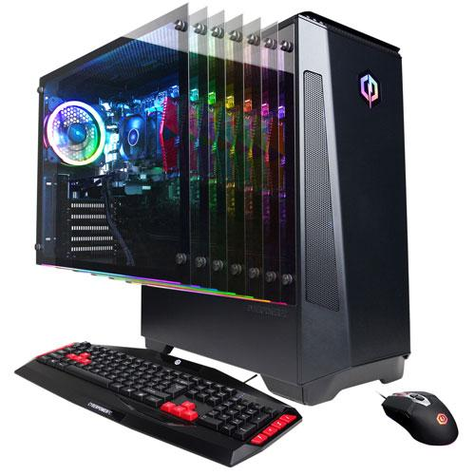
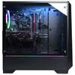
My Budget Machine
I would get a PC only because I already have something for portability which is my laptop. I would get the CyberPowerPC Gaming PC which is for $729.99 on Best Buy. I would get this because it is a very high performance computer that has a very powerful AMD Ryzen 3 2300X processor with 8GB DDR4 RAM and large 1TB hard drive and has the Radeon RX 560 graphics card with 2GB of video memory which runs very fast and smoothly. It looks very nice from the outside with its RGB lights on the inside and you will save $70

Slide 5
My Dream Machine
For my dream machine I would get a desktop. I would buy the CYBERPOWERPC Gamer Supreme because it has an Intel Core i7-9700K, RTX 2080 Super 8GB video card, 16GB of RAM, and a 1TB PCIe-based solid-state drive, all at a price that's incredibly reasonable for a pre-built machine. It has very good speed and it can run most games at a high performance. This PC can also be used for school work as it is very fast.

